Slide 1
ECO Cost-Effectiveness Advisory Committee Meeting 2
August 12, 2024
Anthony Fryer| Commerce
Adam Zoet| Commerce
Grey Staples | Mendota Group, LLC

Slide 2
Agenda
Time | Topic
10:00 – 10:10 | Welcome
10:10 – 10:55 | Updates to MN Policy Inventory – MN Test Framework
10:55 – 11:00 | Break
11:00 – 11:30 | Utility System Impacts – Need for Updates?
11:30 - 11:55 | Xcel Energy Presentation on Distribution Avoided Costs Study
11:55 – 12:00 | Next Steps

Slide 3




Introductions

Slide 4
Advisory Committee Members
Name | Organization |  | Name | Organization |  | Name | Organization
Adway De | Commerce |  | Jeremy Petersen | Xcel Energy |  | Luke Anderson | Xcel Energy
Adam Zoet | Commerce |  | Jessica Peterson | Xcel Energy |  | Marty Kapsch | CenterPoint Energy
Amalia Hicks | Cadmus |  | Jill Eide | Great River Energy |  | Marty Kushler | American Council for an Energy-Efficient Economy
Andy Bahn | Commerce |  | John O'Neil | Southern Minnesota Municipal Power Agency |  | Matt Haley | Frontier Energy
Anthony Fryer | Commerce |  | Josh Mason | Rochester Public Utilities |  | Matt Wisnefske | Cadmus
Ari Zwick | Commerce |  | Julie Michals | E4TheFuture |  | Michael Hinde | Minnesota Valley Electric Cooperative
Audrey Partridge | Center for Energy and Environment |  | Karl Shlanta | Xcel Energy |  | Michelle Rosier | Minnesota Public Utilities Commission
Brandon Crawford | Citizens Utility Board of Minnesota |  | Kathy Baerlocher | Great Plains Natural Gas |  | Nick Mark | Xcel Energy
Caitlin Eichten | Fresh Energy |  | Katie O’Rourke | Minnesota Energy Resources Corp |  | Nick Minderman | Xcel Energy
Cassie Theisen | Minnesota Power |  | Kavita Maini | Minnesota Chamber of Commerce |  | Nick VanDuzee | CenterPoint Energy
Cory Hetchler | Connexus Energy |  | Kevin Lawless | The Forward Curve |  | Noah Halmar | Commerce
Courtney Lane | Synapse Energy Economics |  | Kim Lillyblad | Minnesota Municipal Power Agency |  | Rachel Sours-Page | Mendota Group
Cristina Zuniga | Otter Tail Power |  | Kristin Piontek | Minnesota Power |  | Russ Landry | Center for Energy and Environment
David Bael | Minnesota Pollution Control Agency |  | Kristine Anderson | Greater Minnesota Gas |  | Sami Khawaja | Cadmus
Ethan Warner | CenterPoint Energy |  | Kyle Schleis | Connexus Energy |  | Tim Woolf | Synapse Energy Economics
Gregory Ehrendreich | Midwest Energy Efficiency Alliance |  | Kurt Hauser | Missouri River Energy Services |  | Will Nissen | Minnesota Public Utilities Commission
Grey Staples | Mendota Group |  | Laura Silver | Commerce |  | Wyatt Miller | Minnesota Power
Jamie Stallman | Great River Energy |  | Lauren Sweeney | Commerce |  | Yunpei Zhang | Minnesota Public Utilities Commission
Jason Grenier | Otter Tail Power |  | Lisa Beckner | Minnesota Power |  | Zach Froio | Minnesota Energy Resources Corp
Jeanette LeZaks | Slipstream |  | Lloyd Kass | Franklin Energy |  | Zach Klabo | Montana - Dakota Utilities Company

Slide 5
Welcome
Welcome to the second meeting of the Cost Effectiveness Advisory Committee.
This process will consider proposed changes and updates to the Minnesota cost-effectiveness test.
We are recording the meeting but will only use it to revise notes.
We encourage comments and questions, either live or through chat.

Slide 6
Updates to MN Policy Inventory – MN Test Framework
The previous CAC followed the National Standard Practice Manual 5-step process to develop the Primary Test for cost-effectiveness → MN Test.
When policies change, it’s useful to refresh the Policy Inventory that guides priority policy goals.
Step 1
Step 2
Step 3
Step 4
Step 5
Set Policy Goals
Include all utility system impacts
Select Non-Utility System Impacts
Ensure benefits and costs are properly addressed
Comprehensive, transparent documentation
Notes:
Emphasize that NSPM says to include (and MN test does) all utility system impacts.

Slide 7
Updates to MN Policy Inventory – MN Test Framework
SF 4942 included key changes to the Energy Conservation and Optimization (ECO) Act of 2021.
  The changes did not meaningfully alter Minnesota’s policy priorities, except to further emphasize the important role that Efficient Fuel-Switching will play in utility ECO portfolios.
  Significant changes to ECO Act included:
    Removing electric IOU spending cap on EFS improvements
    Authorizing electric utilities to file for separate EFS financial incentive plans
    Simplifying the method by which IOUs and COUs calculate EFS GHG impacts, allowing use of annual values rather than hourly.
Major changes during 2023 session (100% carbon-free by 2040, funding for multiple initiatives, commercial codes updates) – but don’t impact CE

Slide 8
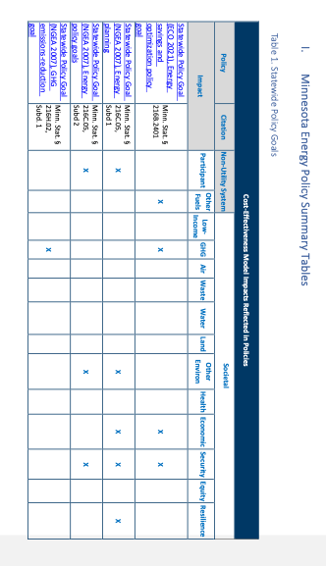
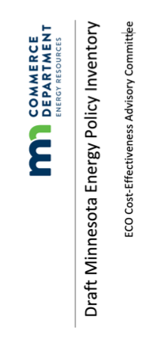
Updates to MN Policy Inventory – MN Test Framework
We will walk through the document during the meeting.

Slide 9
Updates to MN Policy Inventory – Walk Through
Changes to the document include:
  Purpose of the document and document organization information at the beginning.
  (minimal) Updates to tables reflecting updates to policies related to MN Test elements.
  Amendments to Next Generation Act of 2007 related to GHG emissions targets.
  Amendments to NGIA of 2021 related to disadvantaged communities/environmental justice areas.
  Changes to ECO Statutory requirements (pp. 27 – 53).

Slide 10

Questions

Slide 11
Utility System Impacts – Need for Updates?
The table shows the Utility System Impact components of MN Test that are currently quantified and those that are not.
  Blue are areas that the CAC may consider revising or revisiting.
It is important to note the Order Points from 3/31/23 Department Decision:
  Explore marginal energy cost sources that provide greater transparency;
  Determine if accurate, publicly available gas commodity cost forecasts exists and can be used
  In TRM, expected useful lives > 20 years (TRM 4.1 has updates: GSHP = 25 yrs; Res Insulation/Air Sealing = 35 years)
The Department wants to hear from CAC members regarding its current thinking related to elements of USIs to revisit/revise for the next Triennial.
The process to revise values is currently planned for 2025, although the effort is anticipated to begin in 2024.
  This list will include both Utility System Impacts and Non-Utility System/Societal Impacts.

Slide 12
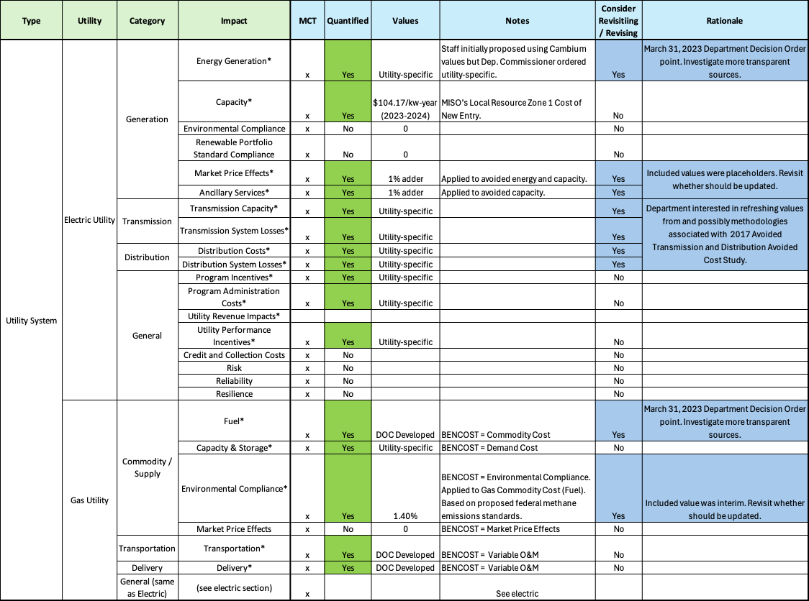

Slide 13
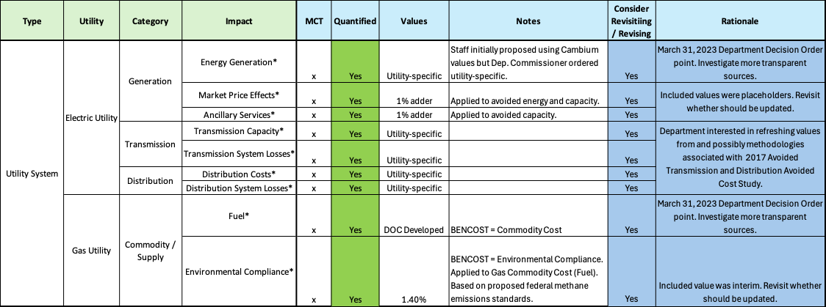
Utility System Impacts – Need for Updates?

Slide 14
Questions

Slide 15






Back at 10:40

Slide 16
Xcel Energy Presentation on Distribution Avoided Costs Study
Department’s September 29, 2017, Decision in Docket CIP-16-541 ordered electric IOUs to use the “Discrete Approach” to estimate electric utility avoided Transmission and Distribution costs.
  The recommendation resulted from a study the Department commissioned from a Third-Party Evaluator; the Third-Party Evaluator’s study was informed by a Technical Advisory Committee consisting of utilities and other interested parties.
The Department is currently discussing its interest in updating utilities' avoided transmission and distribution costs with utilities.
The Department is also interested in what Xcel Energy is doing to update its avoided Distribution costs and how this could benefit other electric utilities and their updates.

Slide 17


Temporal Distribution Cost study proposal
August 12, 2024

Slide 18

Agenda & Objectives
- Summarize Historical (2017) T&D Study
Emerging Trends Requiring New Approach for Distribution
Proposed Temporal Distribution Study vs Historical Study
Preliminary Results (Public Service of Colorado 2030)
Key Topics and Recommendations

Slide 19
Historical 2017 T&D Study – Distribution Avoided Cost
Historical Process
6. Summarize by Year and Escalate
2 Determine the Impact of DSM
4. Determine Value of Avoided Mitigations
  Annual Analysis
  Based on rated capacity of node
  If load w/o DSM exceeds capacity and load w/ DSM less than capacity = Avoided Mitigation
  Split by Banks and Feeders
  Discrete Approach
  Continuous Approach
  Divide by total cumulative kW to determine $/kW
  5-yr forecast
  Estimated at the hour of total distribution system annual peak (kW)
  Estimated for each node (Feeder or Bank)
  Limited to Energy Efficiency
  Estimated at the hour of total distribution system annual peak (kW)
  Impact spread across distribution nodes by constant % of peak reduction
  Average $/kW over 5-yr analysis period
  Escalate beyond analysis period with assumed escalation rate
  Determine cost of mitigation options (switching, replace bank, new feeder, etc.)
  Determine probability of each mitigation
  Calculate probabilistic cost for Banks and Feeders
1. Forecast Load on Distribution System
3. Determine Mitigations Impacted by DSM
5. Apply Mitigation Costs to Avoided Mitigations

Slide 20
Emerging Trends Requiring New Approach for Distribution
  Anticipated Electrification
    Expected to produce distribution peaks across year
        Winter Peaks due to space heating electrification - Peaks across year due to water heating and process heating electrification
        Impact of peak increase (5 kW or greater) larger than historical reduction from energy efficiency – Large impacts on distribution system
        Requires Hourly Analysis across Year (8760)
    Significant Increase in Long-Term Electric Sales Growth
        Historical growth (1-3%) and Energy Efficiency reduction (1-3%) | Future growth (3-6%) and Energy Efficiency reduction (1-2%)
        Escalation of short-term impacts (5-years) not good proxy of long-term impacts due to threshold capacity of distribution nodes
  Improved Data Available and Accessible
    LoadSEER improvements – forecasts of load at distribution nodes – propensity models of electrification adoption
    Tools to process large datasets emerging – Python code – Larger Excel spreadsheets

Slide 21
Proposed Temporal Distribution Study vs Historical Study
1. Forecast Load on Distribution System
2 Determine the Impact of DSM
  HISTORICAL METHOD
  5-yr forecast
  Estimated at the hour of total distribution system annual peak (kW)
  Estimated for each node (Feeder or Bank)
  PROPOSED METHOD
  25-yr forecast
  Estimated for each hour of year
  Estimated for each node (Feeder or Bank)
  HISTORICAL METHOD
  Limited to Energy Efficiency
  Estimated at the hour of total distribution system annual peak (kW)
  Impact spread across distribution nodes by constant % of peak reduction
  PROPOSED METHOD
  Includes Energy Efficiency and Electrification
  Estimated for each hour of the year based on loadshape of total EE and EFS portfolios
  Impact spread across distribution nodes by constant % of hourly reduction or load increase

Slide 22
Proposed Temporal Distribution Study vs Historical Study
3. Determine Mitigations Impacted by DSM
4. Determine Value of Avoided Mitigations
  HISTORICAL METHOD
  Annual Analysis
  Based on rated capacity of node
  If load w/o EE exceeds capacity and load w/ EE less than capacity = EE Avoided Mitigation
  PROPOSED METHOD
  Hourly Analysis
  Based on rated capacity of node
  If load w/o EE exceeds capacity and load w/ EE less than capacity = EE Avoided Mitigation
  If load w/ EFS exceeds capacity and load w/o EFS less than capacity = EFS Required Mitigation
  HISTORICAL METHOD
  Determine cost of mitigation options (switching, replace bank, new feeder, etc.)
  Determine probability of each mitigation
  Calculate probabilistic cost for Banks and Feeders
  PROPOSED METHOD
  IDetermine cost of mitigation options (switching, replace bank, new feeder, etc.)
  Determine probability of each mitigation
  Calculate probabilistic cost for Banks and Feeders

Slide 23
Proposed Temporal Distribution Study vs Historical Study
5. Apply Mitigation Costs to Avoided Mitigations
6. Summarize by Year and Escalate
  HISTORICAL METHOD
  Split by Banks and Feeders
  Discrete Approach
  Continuous Approach
  Divide by total cumulative kW to determine $/kW
  PROPOSED METHOD
  Split by Banks and Feeders
  Discrete Approach
  Continuous Approach
  Divide by total cumulative hourly kW reduction (EE) to determine EE $/kW
  Divide by total cumulative hourly kW increase (EFS) to determine EFS $/kW
  HISTORICAL METHOD
  Average $/kW over 5-yr analysis period
  Escalate beyond analysis period with assumed escalation rate
  PROPOSED METHOD
  Calculate $/kW each hour for 25-year period

Slide 24
Preliminary Results (PSCo 2030 vs PSCo 2017 Study)
2017 Study: $8.89/kW @ Annual System Peak Hour (Hour 4894 in Graphs)
2030 Flat Load EE Measure: $15.76/kW
2030 Flat Load EFS Measure: $26.73/kW

Slide 25
Key Topics and Recommendations
  Clean Transportation – Electric Vehicles
    Include in load forecast
  Demand Management / Demand Response (DM/DR)
    Mass Market DM/DR Program executed for generation benefit – Use EE 8760 $/kW Distribution Savings
    Geo-Targeted DM/DR Program – Model as a Non-Wires Alternative asset rather than 8760 $/kW
  Study Oversight
    Hire 3rd party to review study process and results
    Determine level of data exchange needed for approval
  Application
    Perform study for 2027-2029 Triennial Period
    Use Xcel results as proxy for all electric utilities
          Electrification across all electric utilities expected to require 8760 analysis to accurately capture impacts
          In the case that other electric utilities do not have resources to run 8760 analysis for 25 years

Slide 26
Questions

Slide 27


Next Steps

Slide 28
Timeline
Phase 1: Identifying Priority Updates/Changes (Bi-Monthly Meetings)
Meeting 1 (June 3, 2024): Kick-Off ✓
Meeting 2 (August 2024): Discuss updates to MN’s applicable policy goals and whether they merit any changes to the non-utility system impacts included in the MN Test’s framework. Discuss currently included utility system impacts. Identify whether method updates are needed. Discuss new/additional utility system impacts to prioritize including in the tests. ✓
Meeting 3 (October 2024): Discuss feedback from CAC members. Discuss currently included non-utility system impacts. Identify whether method updates are needed. Discuss new/additional non-utility system impacts to prioritize including in the tests.
Notes:
Adjust October plan if needs to be fine-tuned.

Slide 29
Thank You!
Anthony Fryer
Anthony.fryer@state.mn.us
Adam Zoet
Adam.zoet@state.mn.us
Grey Staples
gstaples@mendotagroup.com

