Slide 1
ECO Cost-Effectiveness Advisory Committee Meeting 5
February 10, 2025
Anthony Fryer| Commerce
Adam Zoet| Commerce
Grey Staples | Mendota Group, LLC

Slide 2
Agenda
Time | Topic
10:00 – 10:10 | Welcome
10:10 – 10:20 | Summary of CAC Feedback Following Meeting 4
10:20 – 10:30 | Overview of New CAC Webpage
10:30 – 10:55 | Progress on Updating Utility System Impacts and Non-Utility System Impacts
10:55 – 11:00 | BREAK
11:00 – 11:30 | Continued Discussion
11:30 – 11:55 | Other Updates from CAC Members?
11:55 – 12:00 | Next Steps
2/10/25

Slide 3




Introductions
2/10/25

Slide 4
Advisory Committee Members
Name | Organization |  | Name | Organization |  | Name | Organization
Adway De | Commerce |  | Jason Grenier | Otter Tail Power |  | Luke Anderson | Xcel Energy
Alex Pruett | Rochester Public Utilities |  | Jeanette LeZaks | Slipstream |  | Mariko Yatsuhashi | Center for Energy and Environment
Amalia Hicks | Cadmus |  | Jennifer Holmes | Michaels Energy |  | Marty Kapsch | CenterPoint Energy
Andy Bahn | Commerce |  | Jeremy Petersen | Xcel Energy |  | Marty Kushler | American Council for an Energy-Efficient Economy
Anthony Fryer | Commerce |  | Jessica Peterson | Xcel Energy |  | Matt Haley | Frontier Energy
Ari Zwick | Commerce |  | Jill Eide | Great River Energy |  | Matt Wisnefske | Cadmus
Ashly McFarlane | Center for Energy and Environment |  | John O'Neil | Southern Minnesota Municipal Power Agency |  | Michael Hinde | Minnesota Valley Electric Cooperative
Audrey Partridge | Center for Energy and Environment |  | Josh Mason | Rochester Public Utilities |  | Michelle Rosier | Minnesota Public Utilities Commission
Brandon Crawford | Citizens Utility Board of Minnesota |  | Julie Michals | E4TheFuture |  | Nick Mark | Xcel Energy
Caitlin Eichten | Fresh Energy |  | Karl Shlanta | Xcel Energy |  | Nick Minderman | Xcel Energy
Carl Nelson | Center for Energy and Environment |  | Kathy Baerlocher | Great Plains Natural Gas |  | Noah Halmar | Commerce
Cassie Theisen | Minnesota Power |  | Katie O’Rourke | Minnesota Energy Resources Corp |  | Rachel Sours-Page | The Mendota Group
Cory Hetchler | Connexus Energy |  | Kavita Maini | Minnesota Chamber of Commerce |  | Russ Landry | Center for Energy and Environment
Courtney Lane | Synapse Energy Economics |  | Kevin Lawless | The Forward Curve |  | Sam Friesen | Fresh Energy
Cristina Zuniga | Otter Tail Power |  | Kim Lillyblad | Minnesota Municipal Power Agency |  | Sami Khawaja | Cadmus
David Bael | Minnesota Pollution Control Agency |  | Kristin Piontek | Minnesota Power |  | Tim Woolf | Synapse Energy Economics
David Pudleiner | ICF |  | Kristine Anderson | Greater Minnesota Gas |  | Tyler Glewwe | CenterPoint Energy
Ethan Warner | CenterPoint Energy |  | Kyle Schleis | Connexus Energy |  | Will Nissen | Minnesota Public Utilities Commission
Gregory Ehrendreich | Midwest Energy Efficiency Alliance |  | Kurt Hauser | Missouri River Energy Services |  | Wyatt Miller | Minnesota Power
Grey Staples | The Mendota Group |  | Laura Silver | Commerce |  | Zach Froio | Minnesota Energy Resources Corp
Isabel Ricker | Minnesota Public Utilities Commission |  | Lauren Sweeney | Commerce |  | Zach Klabo | Montana - Dakota Utilities Company
Jake Millette | Michaels Energy |  | Lisa Beckner | Minnesota Power
Jamie Stallman | Great River Energy |  | Lloyd Kass | Franklin Energy

Slide 5
Welcome
Welcome to the fifth meeting of the Cost Effectiveness Advisory Committee.
This process will consider proposed changes and updates to the Minnesota cost-effectiveness test.
We are recording the meeting but will only use it to revise notes.
We encourage comments and questions, either live or through chat.
2/10/25

Slide 6




Summary of CAC Feedback Following Meeting 4
2/10/25

Slide 7
Refresher on December 9 Meeting
Discussed feedback on E4theFuture Open-Source Cost-Effectiveness Model.
Discussed NUSIs and USIs selected for update in 2025.
Discussed proposed approach for updating/quantifying Utility System Impacts (USIs) and Non-Utility System Impacts (NUSIs).
Discussed plans for February Advisory Committee meeting.

Slide 8
Refresher on December 9 Meeting
The proposed workstreams were:
  Updates to Utility System Impacts (A)
  Updates to Non-Utility System Impacts (B)
  Other Updates (C)
  Draft / Review of Eﬃcient Fuel-Switching and Load Management Cost-Eﬀectiveness Guidelines (D)

Slide 9
Approach for Quantifying Impacts / Updating Cost-Effectiveness Models
Other Updates include:
  Considering role that Secondary Tests should play, particularly related to EFS.
  Required fixes to BENCOST model such as extending measure/project lifetimes (Order Point 6d).
Additional Order Points -
  5d: avoided marginal energy costs that can be shared publicly (provided they are the most up-to-date), and
  6c: related to the BENCOST Commodity Cost input, whether there is publicly available data source for Minnesota forecasted natural gas prices.

Slide 10
Approach for Quantifying Impacts / Updating Cost-Effectiveness Models
Regarding electric avoided marginal energy costs, the Department recognizes that challenges exist in finding values that can be made publicly available.
  The Cambium database suggested in Staff’s Proposed Decision has problems, most notably inconsistency with the values utilities use in resource planning.
For the BENCOST Commodity Cost input, the Department remains interested in determining if there are available, non-proprietary gas price forecasts.
  The PUC has ordered (Docket CI-21-565, 10/28/24) that utilities file Natural Gas Integrated Resource Plans; however, these are not anticipated until 7/1/26 (Xcel), 7/1/27 (CenterPoint), and 7/1/28 (MERC) – with decisions issued within 18 months of filing.

Slide 11


Approach for Quantifying Impacts / Updating Cost-Effectiveness Models (Updates to USIs and NUSIs)
(December) Will establish web page with sections for information related to Utility System Impacts and Non-Utility System Impacts (A, B, C).
  Will post tracking spreadsheet that includes monthly updates regarding progress in reviewing impacts and information collected to date.
  Will provide opportunity for stakeholder comments/contributions to collected information.
  Monthly emailed progress updates.
(February) CAC meeting with presentations regarding information collected, proposed estimates, and issues identified. Need for Ad Hoc meetings. (A,B,C)
(April) CAC meeting with updates to USI and NUSI progress. Need for Ad Hoc meetings. Updates on Open-Source Cost-Effectiveness Tool. (A,B,C)

Slide 12
Approach for Quantifying Impacts / Updating Cost-Effectiveness Models (Updates to USIs and NUSIs)
(June) CAC meeting to discuss near-final methodology details, draft estimates. Next steps leading up to Proposed Decision filing. (A,B,C,D)
  Draft Cost-Effectiveness Updates Summary document issued between meetings.
(August) CAC meeting will discuss the draft Cost-Effectiveness Updates Summary Document and CAC feedback.
  Draft EFS/Load Management Cost-Effectiveness Guidance issued between meetings.
(December) CAC meeting to discuss feedback on Draft EFS/Load Management Cost-Effectiveness Guidance.
(Q1 2026) Deputy Commissioner Decision on 2027—2029 ECO Cost-Effectiveness Methodologies for Electric and Gas Investor-Owned Utilities.

Slide 13
Proposed Approach for Quantifying Impacts/Updating Cost-Effectiveness Models
Dec.
Feb.
April
June
August
Dec.
Q1-2026*
CAC Meetings
Email Updates
USI
NUSI
Other
Guidance
Discuss near-final methodology details, draft estimates
Discuss feedback on Draft Cost-Effectiveness Summary Document
Discuss feedback on Draft EFS/LM Cost-Effectiveness Guidance Document
Collect Info, Develop Preliminary Estimates, Issues Identified
Refine estimates, Ad Hoc Meetings, Update on Open-Source Model
Web Page Set-Up
Issue Draft Cost-Effectiveness Updates Summary Document
Distribute Staff’s Draft EFS/LM Guidance document
Deputy Commissioner Decision on 2027—2029 ECO Cost-Effectiveness
* December 2025 may be last meeting.
Notes:
Might be helpful to pause on this slide and ask the CAC if they have any questions or feedback about the current timeline and approach. Or, were you planning to do that as part of Slide 14? Anyway, I think Slide 13 is a great visual that helps summarize the information you present in this section of the presentation and helps attendees visualize the process as a whole.

Slide 14
Feedback on Plan for 2025 to Update/Quantify Impacts
Only question from members related to whether the Department expected that CAC members would be supplying information to update/quantify the impacts.
  Mendota Group will be primarily responsible for updating the factors;
  The Department welcomes input from CAC members if they have information relevant to the proposed updates;
  The Department will request feedback regarding progress to date.
Any other feedback?

Slide 15



Updated Cost-Effectiveness Advisory Committee Web Page
2/10/25

Slide 16
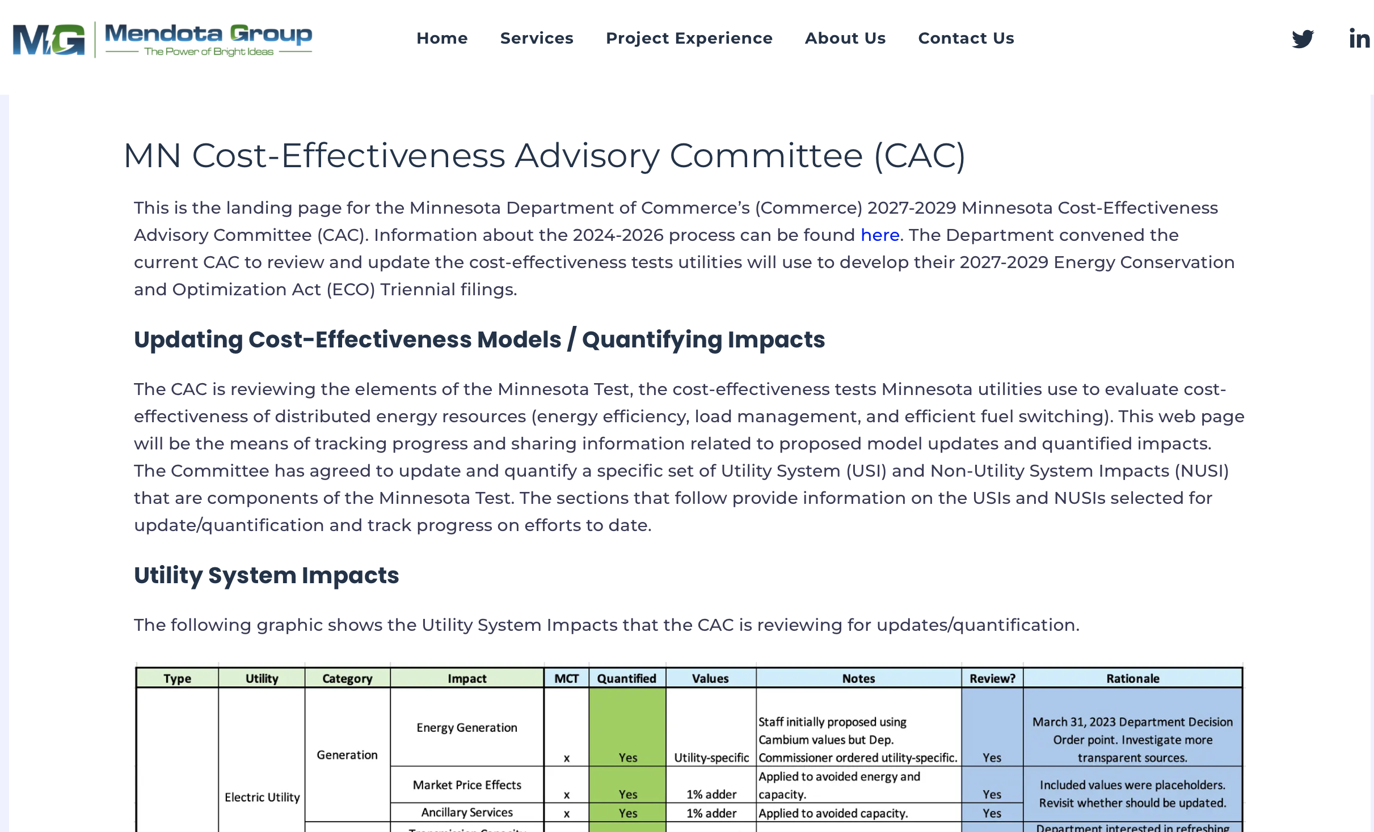
MN CAC Website
https://mendotagroup.com/mn-cost-effectiveness-ac/

Slide 17
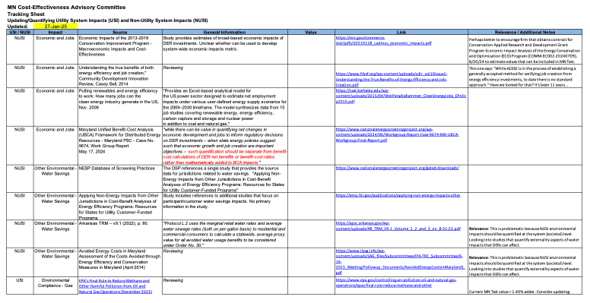
MN CAC Website
Tracking sheet

Slide 18
MN CAC Website
Currently, we are placing updates in the Tracker document.
We are also sending out monthly updates regarding progress.
Are there other documents we should post to the web site?
Would CAC members prefer to post comments to the web site or does email work fine for submitting comments?
Any other feedback?

Slide 19
Progress on Updating Utility System Impacts and Non-Utility System Impacts
2/10/25

Slide 20
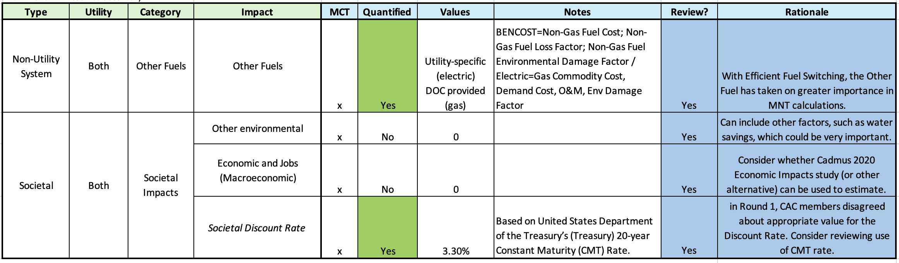
NUSI Elements Selected for Review

Slide 21
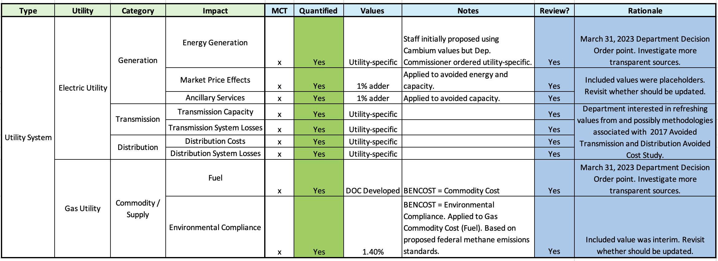
USI Elements Selected for Review

Slide 22
Progress on Updating Utility System Impact and Non-Utility System Impacts
Our goals are to:
  Clearly define the specific NUSIs and USIs identified for update/quantification;
  Research ways that other jurisdictions and/or studies have sought to define and quantify the impacts;
  Assess these sources and data for applicability to Minnesota, and
  Determine how we can develop Minnesota-specific values that could be incorporated into the Minnesota Test.

Slide 23
Progress on Updating Utility System Impact and Non-Utility System Impacts
In reviewing/updating the values, we continue to adhere to the National Standard Practice Manual’s (NSPM) view (particularly for NUSIs) that BCA tests should include those impacts that:
  Align with the jurisdiction’s policy goals;
  Are relevant and material (emphasis added) - including those that may be difficult to quantify or monetize;
    Material is defined as those impacts of “sufficient magnitude to affect the result of the BCA” (NSPM, 2020, p. vi.).
Although it is unclear what “affect the result of the BCA” means, it’s likely that impacts that would constitute less than a 1 percent impact on overall test results are too low.
  The current MN Test includes two proxies equal to 1 percent (Electric Market Price Effects and Electric Ancillary Services) that we are reviewing as part of the current process.

Slide 24
Progress on Updating Utility System Impact and Non-Utility System Impacts
As a resource, the National Energy Screening Project’s (NESP) Database of Screening Practices provides a large volume of information about jurisdictional NUSIs and USIs, along with data sources.
  Located at: https://www.nationalenergyscreeningproject.org/state-database-dsp/
  Unfortunately, in following sources we have not yet found much data to use for updating/quantifying MN Test values.
We have conducted initial research on Other Environmental – Water, and Economic and Jobs (Macroeconomic) Non-Utility System Impacts.

Slide 25
Progress on Updating Utility System Impact and Non-Utility System Impacts
Water Savings
The studies and quantifications related to water have largely focused on Participant/ Customer impacts from reduced water use associated with DERs.
  This focus is different from the broader, system-level impact of environmental (water) externalities which are relevant to NUSIs.
  System-level impacts refer to ways, as an example, fossil-fueled and nuclear power plants use large amounts of water (and associated requirements for water treatment, etc.).
  Reducing generation from these plants due to energy efficiency could be quantified in terms of system/societal savings and incorporated into the MN Test.
  Such an analysis, though, is complicated by the fact that EE would also potentially reduce renewable energy generation which do not have the same cooling requirements.
Notes:
Begs the question – what next? Still looking at the impacts and ways these may be quantified. What’s a reasonable cut-off time for this metric. If CAC members have specific studies they know about, please let us know.

Slide 26
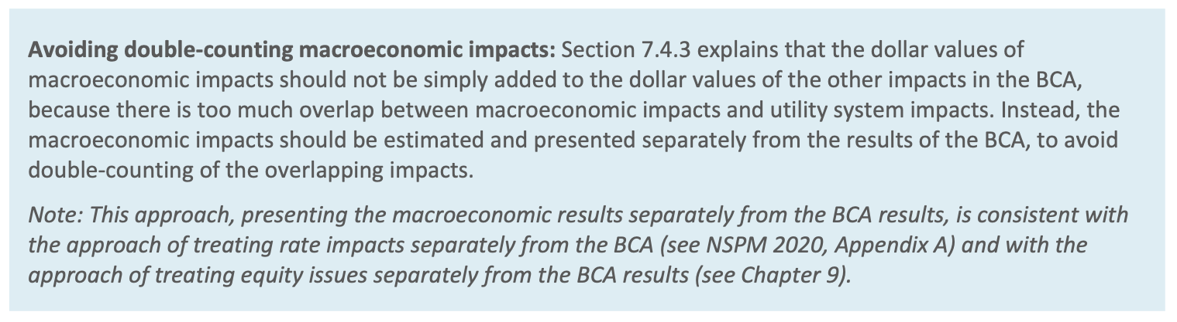
Progress on Updating Utility System Impact and Non-Utility System Impacts
Although there is more information about the Economic/Jobs impacts of DERs, we are continuing to research to see if we can develop a quantified metric that can be incorporated into the Minnesota Test.
We note, however, that the NSPM Methods, Tools and Resources (p. 161) says this:
We welcome input from CAC members regarding things that they may have seen in other jurisdictions.
Notes:
Caution about how to do economic/jobs in a BCA … nspm says that it may be best to do separately; however, we are suggesting …

Slide 27
Progress on Updating Utility System Impact and Non-Utility System Impacts
Mendota Group will continue to research opportunities to develop NUSI metrics that can be incorporated into the Minnesota Test.
We will present more findings at the April CAC meeting – including analysis of USIs.
The Department is interested to know how utility efforts to update avoided Distribution costs are progressing and whether the CAC can provide useful input.
Mendota Group plans to reach out to individual utilities to obtain:
  additional information about updates to estimates of avoided Distribution costs and
  ways to develop better estimates of the Other Fuels Non-Utility System Impact (this applies to Efficient Fuel-Switching: for electric utilities, we’re talking about natural gas and other displaced fuels while, for gas utilities, this would relate to increased electricity use associated).
Notes:
Look at transmission avoided costs.

Slide 28

Questions
2/10/25

Slide 29






Back at 11:00
2/10/25

Slide 30
Continued Discussion / Other Updates from CAC Members
2/10/25
Notes:
Add a slide after this.

Slide 31
Continued Discussion / Updates from CAC Members
Continued Discussion
Open-Source Benefit-Cost Analysis tool expected at beginning of 2026.
  Web site to follow progress is here: https://www.nationalenergyscreeningproject.org/open-source-bca-tool/
Any other items CAC members want to raise or discuss?
Notes:
Look at transmission avoided costs.

Slide 32


Next Steps
2/10/25

Slide 33
Department Staff Requests / Updates
By 2/27/25, please send any written feedback on the following items:
  CAC data sources for specific USI and NUSIs or ideas about methodologies;
  Feedback on today’s meeting presentation content.
2/10/25

Slide 34
Timeline
Phase 1: Identifying Priority Updates/Changes (Bi-Monthly Meetings)
Meeting 1 (June 3, 2024): Kick-Off ✓
Meeting 2 (August 2024): Discussed updates to MN’s applicable policy goals and whether they merit any changes to the non-utility system impacts included in the MN Test’s framework. Discussed currently included utility system impacts. Identify whether method updates are needed. Discussed new/additional utility system impacts to prioritize including in the tests. ✓
Meeting 3 (October 2024): Discussed feedback from CAC members. Discussed currently included non-utility system impacts. Identify whether method updates are needed. Discussed new/additional non-utility system impacts to prioritize including in the tests. ✓
Meeting 4 (December 2024): Department Staff propose plan for quantifying USIs. Electric utilities will continue to work to update avoided Distribution costs. Also, discuss CAC feedback on NUSIs and E4theFuture’s proposed Open-Source Cost-Effectiveness Model. ✓
2/10/25

Slide 35
Timeline
Phase 2: Identifying Priority Updates/Changes (Bi-Monthly Meetings)
Meeting 5 (February 2025): CAC meeting with presentations regarding information collected, proposed estimates, and issues identified. Ad Hoc meeting. ✓
Meeting 6 (April 2025): CAC meeting with updates to USI and NUSI progress. Need for Ad Hoc meetings. Updates on Open-Source Cost-Effectiveness Tool. (A,B,C)
Meeting 7 (June 2025): CAC meeting to discuss near-final methodology details, draft estimates. Next steps leading up to Proposed Decision filing. (A,B,C,D)
  Draft Cost-Effectiveness Updates Summary document issued between meetings.
Meeting 8 (August 2025): CAC meeting will discuss the draft Cost-Effectiveness Updates Summary Document and CAC feedback.
  Draft EFS/Load Management Cost-Effectiveness Guidance issued between meetings.
2/10/25

Slide 36
Timeline
Phase 2: Identifying Priority Updates/Changes (Bi-Monthly Meetings)
Meeting 9 (December 2025) CAC meeting to discuss feedback on Draft EFS/Load Management Cost-Effectiveness Guidance
(Q1 2026) Deputy Commissioner Decision on 2027—2029 ECO Cost-Effectiveness Methodologies for Electric and Gas Investor-Owned Utilities.
2/10/25

Slide 37
Thank You!
Anthony Fryer
Anthony.fryer@state.mn.us
Adam Zoet
Adam.zoet@state.mn.us
Grey Staples
gstaples@mendotagroup.com
2/10/25

